Slide 1
UNDERSTANDING ELECTROCATALYSIS
Alfred B. Anderson
Chemistry Department
Case Western Reserve University
Cleveland Ohio, 44106.
IUPAC World Chemistry Congress, San Juan Puerto Rico, July 31-August 7, 2011

Slide 2
Electrochemical theorists can learn from experimental trends
In solution:
Ox(aq) + e⁻ ⇌ Red(aq)
Ox(aq) + nH⁺(aq) + ne⁻ ⇌ Red(aq)
ΔG(U) = [G_{Red}(U) – G_{Ox}(U)] + n(φ + FU) = zero at equilibrium, at U = U⁰; Red and Ox are in bulk solution and their Gibbs energies are independent of U:
U⁰ = [G_{Ox} - G_{Red}]/(nF) + [G(H⁺) - φ]/(nF)
= [G_{Ox} - G_{Red}]/(nF) + constant
≈ [E_{Ox} - E_{Red}]/(nF) + c
The relationship was discovered 12 years ago. How good is it?
IUPAC World Chemistry Congress, San Juan Puerto Rico, July 31-August 7, 2011

Slide 3
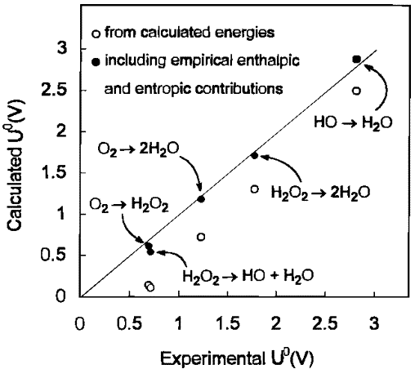
MP2 gas phase energy calculations omitting vibrational zero point energy contributions, Anderson, A. B.; Albu, T. V. “Ab Initio Determination of Reversible Potentials and Activation Energies for Outer-Sphere Oxygen Reduction to Water and the Reverse Oxidation Reaction,” J. Am. Chem. Soc. 1999, 121, 11855-11863.
IUPAC World Chemistry Congress, San Juan Puerto Rico, July 31-August 7, 2011

Slide 4
By adjusting c, the following graph is obtained for the reactions shown with ΔE = [E_{Ox}(U⁰) - E_{Red}(U⁰)]/(nF) calculated for gas phase reactions using B3LYP hybrid density functional theory and a 6-31G** basis.
U⁰ ≈ [E_{Ox} - E_{Red}]/(nF) + c
[1] O₂(g) + H⁺ + e⁻ ⇌ OOH(aq) -0.125
[2] O₂(g) + 2H⁺ + 2e⁻ ⇌ H₂O₂(aq) 0.695
[3] H₂O₂(aq) + H⁺ + e⁻ ⇌ OH(g) + H₂O(aq) 0.713
[4] O₂(g) + 4H⁺ + 4e⁻ ⇌ 2H₂O(l) 1.229
[5] OOH(aq) + H⁺ + e⁻ ⇌ H₂O₂(aq) 1.515
[6] H₂O₂(aq) + 2H⁺ + 2e⁻ ⇌ 2H₂O(aq) 1.763
[7] O(aq) + H⁺ + e⁻ ⇌ OH(g) 2.03
[8] OH(g) + H⁺ + e⁻ ⇌ H₂O(aq) 2.813
Linear Gibbs Energy Relationship (LGER)
Slope = 1.015
Powerful predictive capability.
IUPAC World Chemistry Congress, San Juan Puerto Rico, July 31-August 7, 2011

Slide 5
Why does the model work?
(i) The Gibbs energy of H⁺(aq) and the workfunction of the SHE are
contained in c exactly.
(ii) In each case n O-H bonds form and their zeropoint energies are all
almost the same and are contained in c.
(iii) The solvation energy of Ox is almost the same as the solvation energy of Red because both are uncharged and the small difference is contained in c.
(iv) The TΔS contribution to the Gibbs energy of Ox is almost the same as the TΔS contribution to the Gibbs energy of Red and the small difference is contained in c.
IUPAC World Chemistry Congress, San Juan Puerto Rico, July 31-August 7, 2011

Slide 6
Apply to electrocatalysis?
Probable O₂ reduction mechanism with intermediates bonded to the catalyst. One desires all steps to occur at
the potential for the complete n-electron reaction.
Consider adsorption on the catalyst to perturb the Gibbs energy:
Ox → Ox(ads), define Δ_{ads}G_{ox}(U_{cat}) = G_{ox,ads}(U_{cat}) - G_{ox} - G_{cat}(U_{cat})
Red → Red(ads), define Δ_{ads}G_{red}(U_{cat}) = G_{red,ads}(U_{cat}) - G_{red} - G_{cat}(U_{cat})
IUPAC World Chemistry Congress, San Juan Puerto Rico, July 31-August 7, 2011

Slide 7
When the oxidized and reduced species are bonded to a catalyst, the reversible potential becomes . Now G_{red} and G_{ox} depend on U_{cat} because they are bonded to the catalyst.
ΔG_{ads}(U_{cat}) = [G_{red,ads}(U_{cat}) - G_{ox,ads}(U_{cat})] + n(φ + FU_{cat} )
At equilibrium, ΔG( ) = [G_{red,ads}( ) - G_{ox,ads}( )] + n(φ + F ) = 0.0
= [G_{ox,ads}( ) - G_{red,ads}( )]/(nF) + [G(H⁺) - φ]/(nF)
= [G_{ox,ads}( ) - G_{red,ads}( )]/(nF) + constant
For the same reaction in bulk solution U⁰ = [G_{Ox} - G_{Red}]/(nF) + constant
The shift in reversible potential due to bonding to the catalyst is then
- Uº = Δ_{ads}G_{ox}( ) - Δ_{ads}G_{red}( )]/nF
How accurate is using internal energies at the pcz in - Uº ≈ Δ_{ads}E_{ox}(U_{pzc}) - Δ_{ads}E_{red}(U_{pzc})/nF?
IUPAC World Chemistry Congress, San Juan Puerto Rico, July 31-August 7, 2011

Slide 8
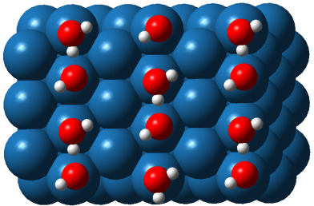
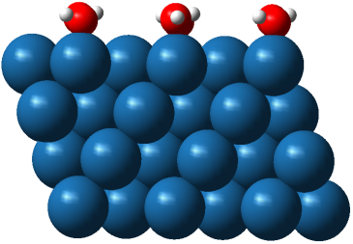
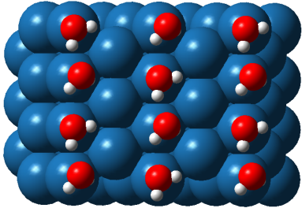
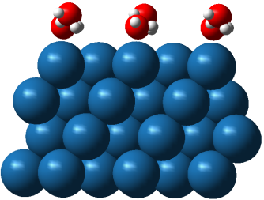
Answer
H⁺(aq) + e⁻
Water + 1.0 M electrolyte modeled by modified Poisson-Boltzmann distribution with dielectric continuum
_________________________________________
Δ Δ
solvation zpe LGER final exptl
_________________________________________
-0.090 0.052 0.86 0.82 ~0.77
_________________________________________
Some of solvation shell stabilization replaced by bond to surface
Based on experimental results of Climent, V.; Gomez, R.; Orts, J. M.; Feliu, J. M. J. Phys. Chem. B 2006,110, 11344-11351 and Wakisaka, M.; Suzuki, H.; Mitsui, S.; Uchida, H.; Watanabe, M. Langmuir 2009, 25, 1897-1900.
Anderson, A. B.; Uddin, J.; Jinnouchi, R. “Solvation and Zero-Point Energy Effects on OH(ads) Reduction on Pt(111) Electrodes,” J. Phys. Chem. C 2010, 114, 14946-14952.
IUPAC World Chemistry Congress, San Juan Puerto Rico, July 31-August 7, 2011

Slide 9
How accurate is using the potential of zero charge, pzc, in
- Uº = [Δ_{ads}G_{ox}(U_{pzc}) - Δ_{ads}G_{red}(U_{pzc})]/nF?
Adsorption bond strengths, 1/6 ML, from Gibbs energies (bold type, eV). ___________________________________________________
adsorbate amount of coadsorbed H₂O
___________________________________________________
0 ML H₂O ½ ML H₂O
pzc U⁰ pzc U⁰
_________________________________________
(0.551) (1.229) (-0.359) (1.229)
H₂O(aq) 0.0 0.036 0.0 0.17
(1.287) (1.229) (-0.055) (1.229)
OH(aq) 1.96 1.96 2.15 2.25
____________________________________________________
Predictions using adsorption energies from above table. The results in parentheses are based on Gibbs energies using the complete interfacial theory. Coverage is 1/6 ML. The experimental value is ~ 0.74 V.
______________________________________________________
reaction reversible potential in presence of
______________________________________________________
0 ML H₂O ½ ML H₂O
pzc’s, 1.229 V pzc’s, 1.229 V
____________________________________
OH(ads) + H⁺(aq) + e⁻
⇌ H₂O(ads) 0.76, 0.80 (0.71) 0.57, 0.64 (0.63)
______________________________________________________
Based on experimental results of Climent, V.; Gomez, R.; Orts, J. M.; Feliu, J. M. J. Phys. Chem. B 2006,110, 11344-11351 and Wakisaka, M.; Suzuki, H.; Mitsui, S.; Uchida, H.; Watanabe, M. Langmuir 2009, 25, 1897-1900.
IUPAC World Chemistry Congress, San Juan Puerto Rico, July 31-August 7, 2011

Slide 10
The reaction 1/6 ML OOH + 1/6 ML OH + 1/6 ML H₂O → 1/6 ML O + 1/3 ML OH + 1/6 ML H₂O is exergonic by -1.21 eV This means the effective four-electron reversible potential, , is ≈ 1.229 - 1.21/ V = 0.93 V.
IUPAC World Chemistry Congress, San Juan Puerto Rico, July 31-August 7, 2011

Slide 11
Overall picture
All U^{rev} calculated, and taken from Tian, F.; Anderson, A. B. “Effective Reversible Potentials, Energy Loss and Overpotential on Platinum Fuel Cell Cathodes,” J. Phys Chem. C 2011, 115, 4076-4088.
OOH formation: experimental E_{a} from Anderson, A. B.; Roques, J.; Mukerjee, S.; Murthi, V. S.; Markovic, N. M.; Stamenkovic, V. “Activation Energies for Oxygen Reduction on Platinum Alloys: Theory and Experiment,” J. Phys. Chem. B 2005, 109, 1198-1203.
H₂O and OH formation: calculated E_{a} from Zhang, T. “Theoretical Studies of Fuel Cell Reaction Mechanisms: H₂ and O₂ on Platinum Electrodes” and Ph. D. Thesis, Case Western Reserve University, 2008
The method used is described in Jinnouchi, R.; Anderson, A. B. “Electronic Structure Calculations of Liquid-Solid Interfaces: a Combination of Density Functional Theory and Modified.Poisson-Boltzmann Theory,” Phys. Rev. B 2008, 772, 2454170-24541718.
IUPAC World Chemistry Congress, San Juan Puerto Rico, July 31-August 7, 2011

Slide 12
Ideal O₂ reduction catalyst, = 1.23 V, based on experimental bulk solution reversible potentials
Reactant (O₂) and product (H₂O) adsorption Gibbs energies ~ zero eV.
Adsorption Gibbs energy of OH is 1.49 eV.
Adsorption Gibbs energy of O is 2.38 eV.
Adsorption Gibbs energy of OOH is 1.35 eV (makes its dissociation energy neutral)
These bond strengths also give 1.23 V four-electron reduction reversible potentials for the alternative initial steps
O₂(g) + H⁺(aq) + e⁻ → O(aq) +OH(aq)
and
OOH(ads) + H⁺(aq) + e⁻ → O(ads) + H₂O(l)
IUPAC World Chemistry Congress, San Juan Puerto Rico, July 31-August 7, 2011

Slide 13
Acknowledgments
Work discussed here has been supported by ARO MURI, Toyota Central R&D, Inc., and, currently, the National Science Foundation.
Persons participating in this effort have been many but those whose work has been quoted are:
Dr. Titus Albu, grad student, now professor at Tennessee Tech.
Dr. Jérôme Roques, post doc, now professor at Institut de Physique Nuclaire d’Orsay, Université Paris.
Dr Tianhou Zhang, grad student, now with a government environmental agency in China.
Dr. Ryosuke Jinnouchi, visiting scientist, now back with Toyota Central R&D, Inc.
Dr. Feng Tian, grad student, now post doc with Don Siegel at the Univ. of Michigan.
Dr. Jamal Uddin, present research associate.
IUPAC World Chemistry Congress, San Juan Puerto Rico, July 31-August 7, 2011

